Slide 1
How recent EU policies on VET and refugees have affected the system? Nina Lahtinen Development Manager, OAJ
Notes:
The number of immigrants has doupled in 2000 century
Recognising prior competencies and education
Language education
Teachers need new skills
Different pathways to education and working life for immigrants

Slide 2
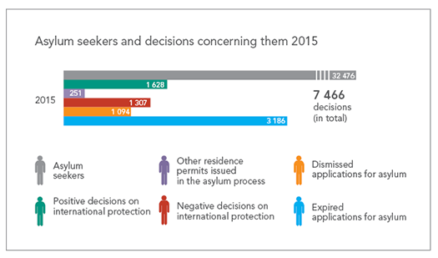
2015 total of 32 476 asylum seekers
http://www.migri.fi/about_us/statistics/statistics_on_asylum_and_refugees
You can always learn more.

Slide 3
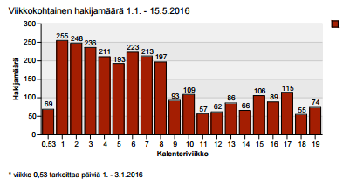
1.1.-15.5.2016 the number of asylum seekers 2 757
Asylum applicants
Number of asylym applicants
weeks
You can always learn more.

Slide 4
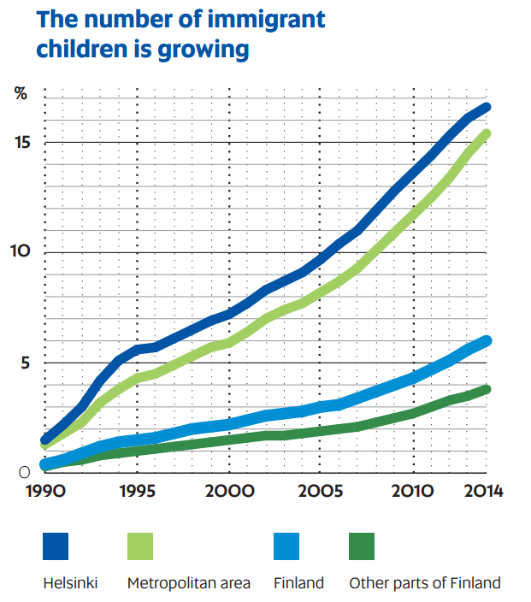
Even without the wave of refugees, multiculturalism is an important and growing part of Finland and its future.
OAJ wants to promote a multicultural and tolerant Finland that carries global responsibility and helps those in need.

Slide 5
Survey of the educational background, work history and learning skills of asylum seekers
a language assessment centre for adult immigrants was commissioned by the Ministry of Education and Culture to carry out a survey of the
language educational background,
work history and
proficiency in reading and writing
of asylum seekers in reception centres in Finland.
The survey was conducted between January and March 2016 and involved interviews with 1,004 asylum seekers from 32 different countries.
You can always learn more.

Slide 6
Educational background
69% have completed from seven to nine years of primary and secondary school
Around 50 % have attended upper secondary school
14 % have competed vocational training.
The low figure for vocational studies might be because many manual and practical jobs are learned on the job in the asylum seekers' countries of origin, so vocational training is not necessarily particularly widespread.
vocational studies of the respondents were mostly in the fields of construction and manufacturing industry.
27 % have studied at tertiary level, 16 % reported having completed a degree, mostly a bachelor's degree
7% have no educational background at all.
You can always learn more.

Slide 7
Prior work experience
90 % have prior work experience
Construction and transport
27 per cent had worked as builders, painters, construction engineers and in other construction industry occupations.
21 per cent had worked as taxi, bus and lorry drivers and in other jobs in the transport sector.
The commercial sector, hotel and catering and the food industry as well as the fields of culture, communications, art and crafts were other major occupational fields.
19 per cent of the respondents had been entrepreneurs.
You can always learn more.

Slide 8
Education is the best integration policy.
OAJ thinks Finland has not been able to take enough concrete measures to promote integration.
That is why OAJ has devised the Integration Compass.
http://www.oaj.fi/cs/Satellite?c=Page&pagename=OAJWrapper&childpagename=OAJ%2FPage%2Fsisalto&cid=1398855048744&contentID=1408913564941
You can always learn more.
Notes:
OAJ emphasises that immigrants of all ages need to gain access to education services as soon as possible after their arrival to ensure that integration begins immediately. Competent teachers want to work toward the goal of giving every person who arrives access to education and working life. OAJ’s Integration Compass provides methods for better integration of children, youth and adults from immigrant backgrounds.
Language acquisition is an important factor in all education. Everyone should be provided with sufficient pedagogical support for learning. Teachers’ multicultural competence also needs reinforcement.

Slide 9
Teacher, who can help immigrants to get
Education
-> diploma,
sertificate
Prior work experience
Language skills
Reception center

Slide 10
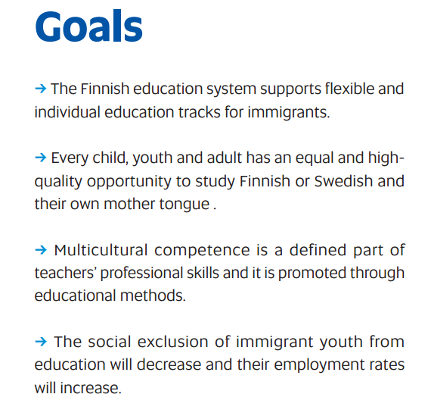
You can always learn more.

Slide 11
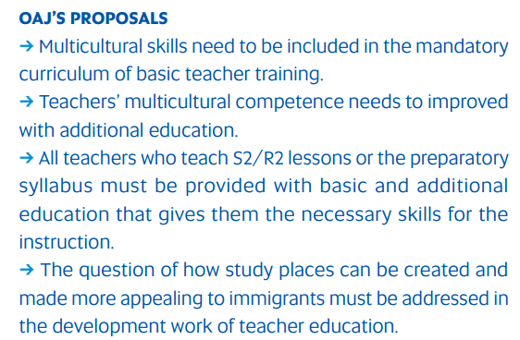
More multicultural skills for teachers
You can always learn more.

Slide 12
You can always learn more.
Notes:
The reception centres

Slide 13
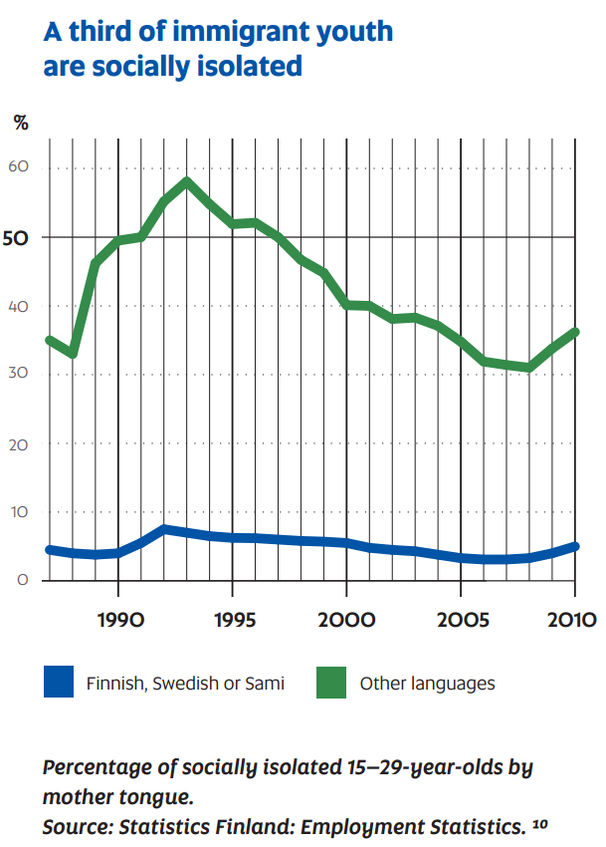
Language is the key that opens many doors.

Slide 14
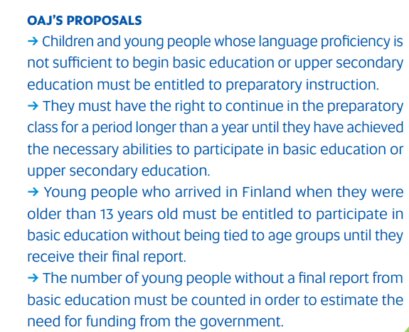
More preparatory instruction is needed

Slide 15
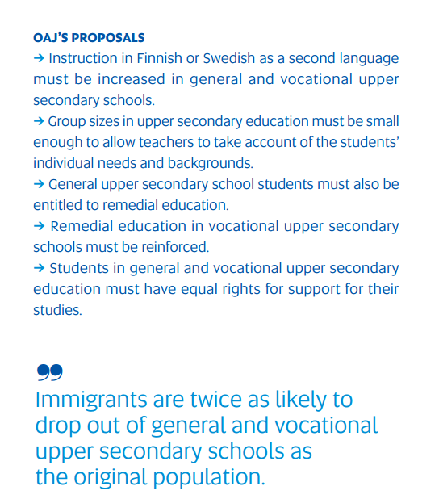
Support is still needed during upper secondary education
In 2012, about 7 percent of all students in vocational education were immigrants.
Notes:
More and more students need support in their studies. Support for immigrants is especially important, because they also need to continue studying the language. In the General Upper Secondary Schools Act, no reference is made to special education , and many immigrants don’t receive the necessary support in their studies. Immigrants tend to be equally likely to apply for vocational education as people from Finnish backgrounds. In 2012, about 7 percent of all students in vocational education were immigrants. A vocational teacher must know how students’ cultural backgrounds should be taken into consideration. Additional training is also needed for this.

Slide 16
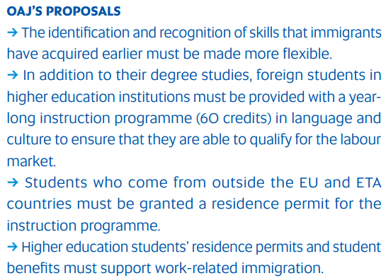
Educated immigrants must be integrated
into the labour market
You can always learn more.

Slide 17
Thank you

